Slide 1


Become Chrome Master With Useful Keyboard Shortcut Keys & Setting

Slide 2
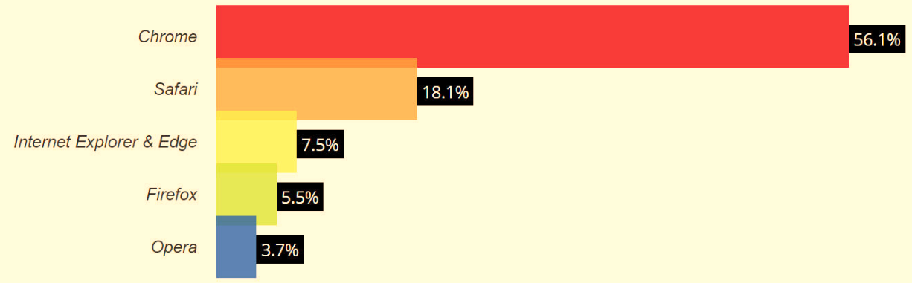

Slide 3
Chrome Setting
How to Set New Page
How to Set Downloads
How to Set Home Button

Slide 4

Bookmark
Press Ctrl + D to make Bookmark

Slide 5
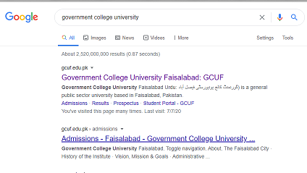
Open Search Sites in New Tab:
Place Cursor on the Link and then Press Ctrl to open in New Tab

Slide 6

Open New Tab:
Press Ctrl + T for New Tab Opening in Browser

Slide 7
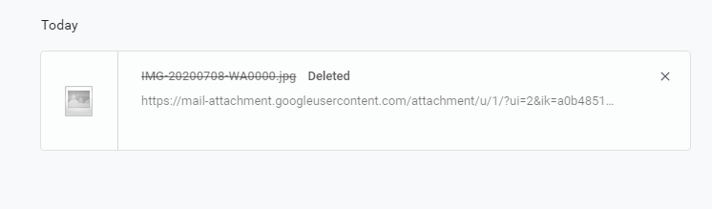
Browser Download History Key:
Use Ctrl + J for Opening Download List

Slide 8
Close Browser Tab:
Use Ctrl + W shortcut Key to Close tabs one by one.

Slide 9
Re-open Closed Tab:
Ctrl + Shift + T

Slide 10

Incognito Mode:
When you want to browse Privately.
This mode blocks Chrome from saving cookies, temporary Internet files that contain your following Information:
IP address
Login details
Other browsing information.

Slide 11

Snap Your Cursor to the Search Bar:
Instead of having to take your hands away from the keyboard to move the cursor to the search bar, use this shortcut to instantly bring your cursor to the search bar to Google something or type in a URL.

Slide 12
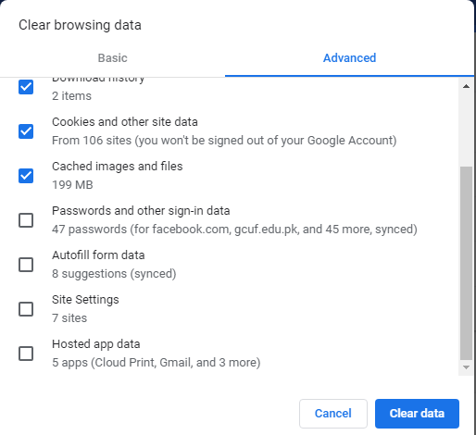

Clear Browsing Data:

Slide 13

Jump Between Next & Previous Tabs:

